Slide 1

Targeting Immune Checkpoint Therapy Resistance with Novel MSC-Engineered Extracellular Vesicles
Yves Greatti
April 29, 2024
Notes:
Hello everyone, today I will introduce my project which consists in designing a novel cancer drug using Mesenchymal Stem Cell-derived Extracellular Vesicles or EVs.

Slide 2
Agenda
Significance
Innovation
Research Strategy
Notes:
The agenda consists in 3 parts, starting with significance.

Slide 3
Significance

Slide 4
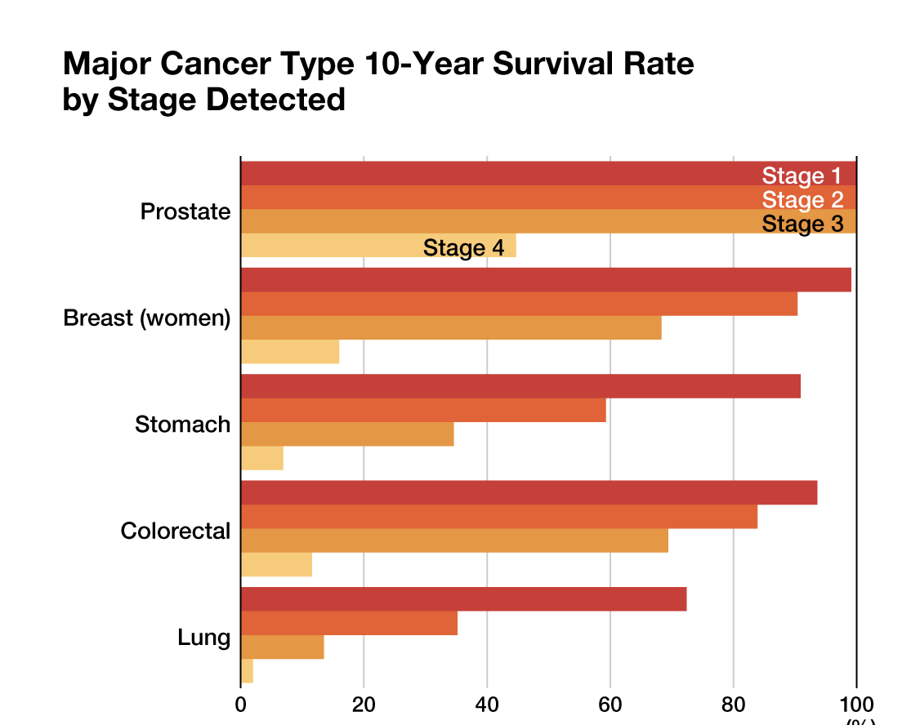
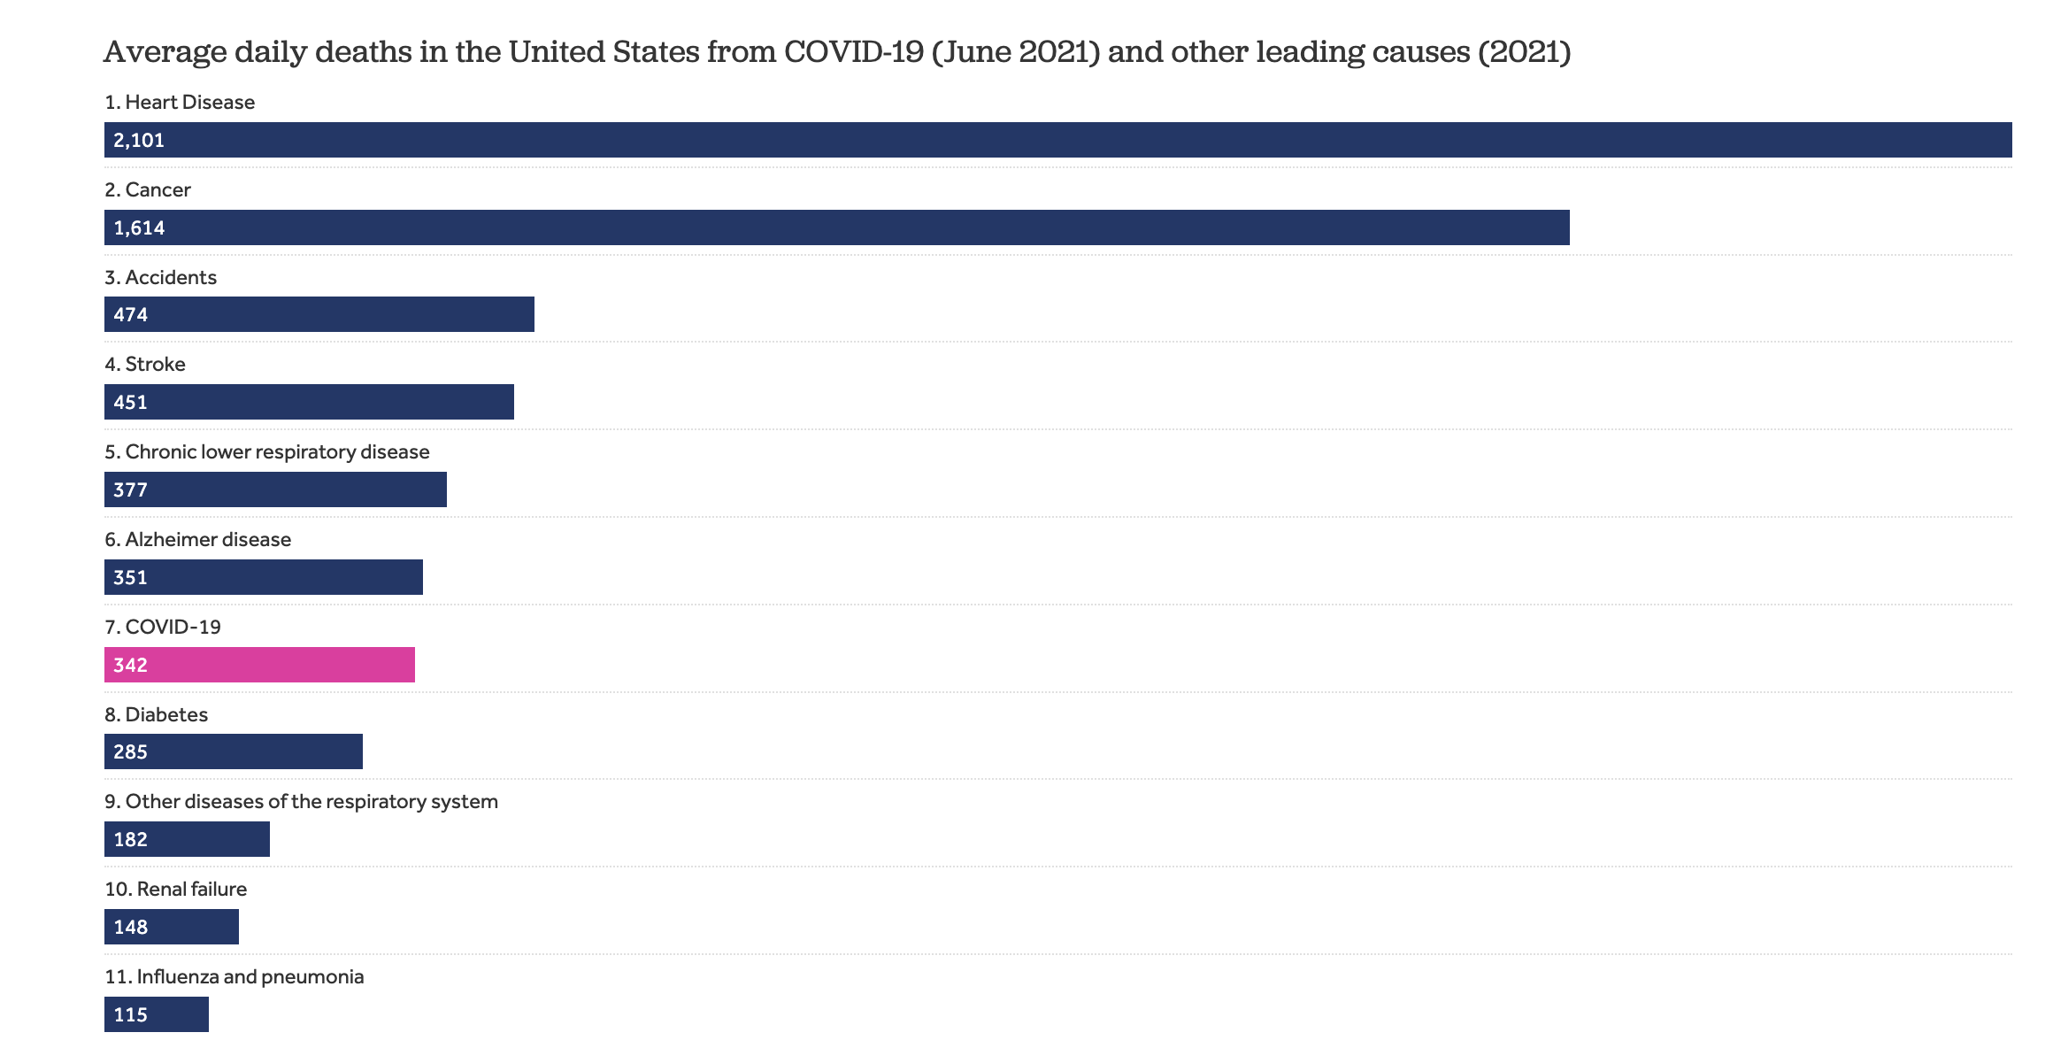
The Persistent Challenge of Cancer Today
2024-cancer-facts-and-figures-acs
Notes:
Although there have been significant improvements in reducing lethality of cancer, in the US, it remains yet a prevalent disease . As you can see in the left chart, at the peak of the pandemic, cancer was ranked number 2 in term of average daily deaths and on the right; there is a steep decline in survival rate for people with stage 4 across different cancer indications.

Slide 5
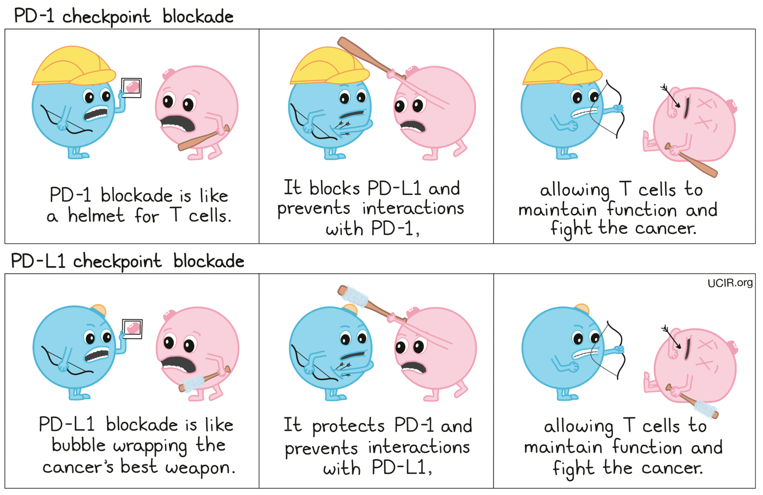
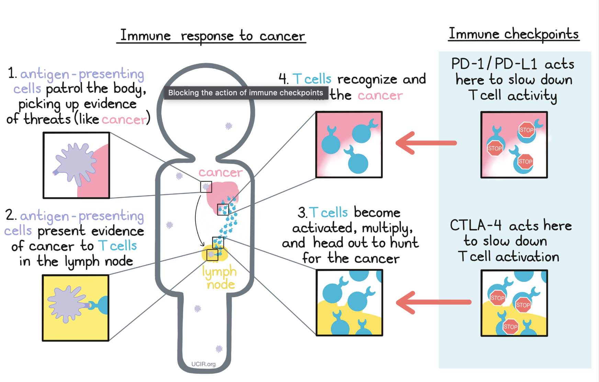
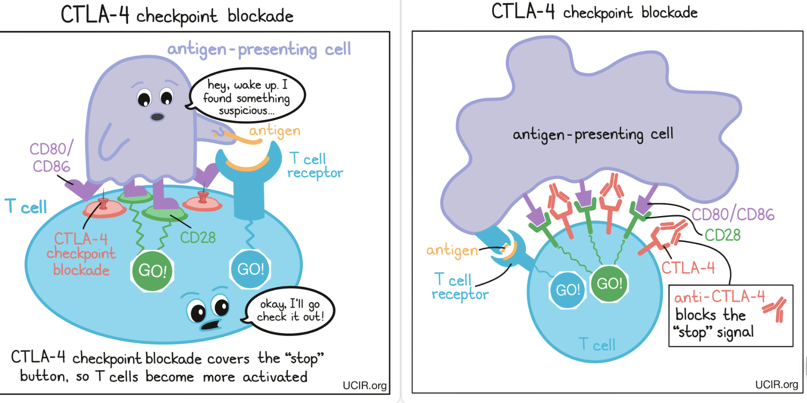
Immune Checkpoint Blockade Therapy
Notes:
let's start with a quick review of two of the most successful immune checkpoint inhibitors and their mechanism of action.
In a healthy immune response, CTLA-4 functions as a brake on T cells to prevent overactivation
Tumors can encourags expression of CTLA-4.
Anti-CTLA-4 therapies are designed so that they specifically bind to CTLA-4, and by blocking CTLA-4, the therapies ensure that T cell activation is restored.
On the other hand, PD-1 is a receptor found on the surface of T cells. And its ligands, PD-L1 and PD-L2, can be expressed on the surface of tumor cells.
Many types of cancer upregulate PD-L1, "instructing" T cells to turn off.
PD1-/PD-L1 immunotherapies, can either bind to PD-1 or PD-L1, blocking their ability to send inhibitory signals to T cells.

Slide 6
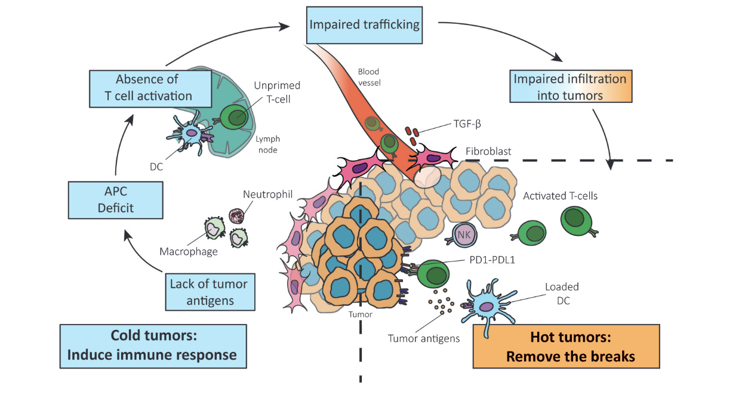
Reversing a Cold Tumor Into a Hot Tumor
Notes:
In "hot" tumors, the main challenge is overcoming the inhibition of the immune response that is induced by the cancer cells.
Recent immunotherapies have seen substantial success in treating "hot" tumors but have been far less effective for "cold" tumors.
In the early stage, cancer is able to evade the immune system by not presenting significant neoantigens.
The second stage of immune response to the tumor involves the presentation of these tumor antigens by dendritic cells (DCs), which leads to the priming and activation of T cells that can attack the cancer.
However, the lack of tumor antigen results in a deficiency in the recruitment of antigen presenting cells (APCs).
This, in turn, leads to a lack of co-stimulation and activation of T cells.
Moreover, altered production of chemokines and cytokines, can affect cell trafficking and infiltration.
All these factors result in the exclusion of CD8+ T cells by the stroma of the tumor.
The stroma environment prevents T cells from reaching the cancer cells.
The drug we designed addresses the challenge presented by cold tumor and strengthen the effects of immune checkpoint inhibitors.

Slide 7
Agenda
Significance
Innovation
Research Strategy

Slide 8
Innovation

Slide 9
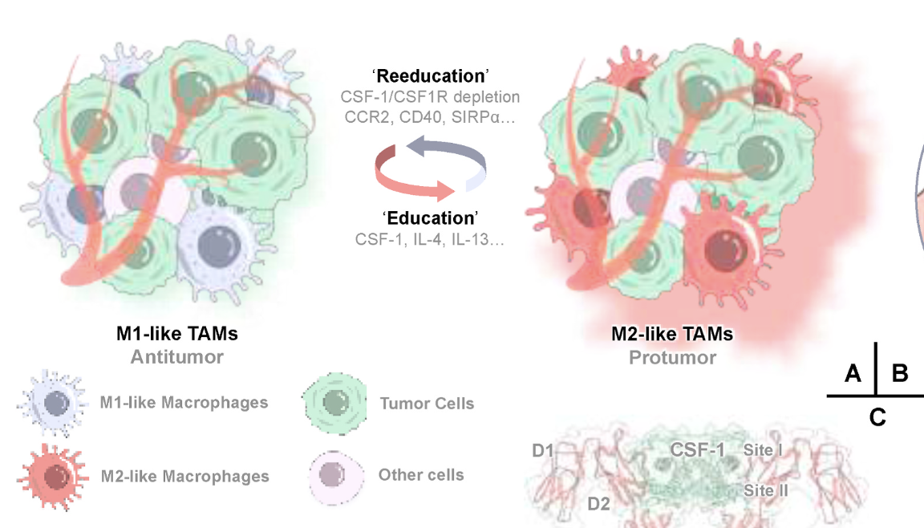
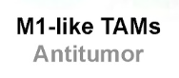
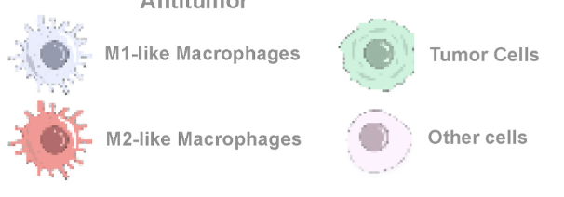
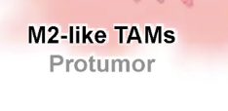
CSF-1/CSF1R Inhibitors modify Tumor Associated Macrophages (TAMs) behavior within the TME
CSF1R inhibitors are emerging immunotherapeutic drugs for cancer treatment. Jiachen Wen et al.
Notes:
Macrophages polarize into two subtypes following infiltration to tumor tissue, with M1-like macrophages characterized by biomarkers of CCR7, CD40, CD11c, and M2-like macrophages by markers of CD169, or CD206.
M1-like and M2-like TAMs, have the capacity to transition between each other under stimulation of various cytokines and chemokines termed here as
‘education’ or ‘reeducation’ factors. CSF-1R inhibitors can modify the behavior of the TAMS and reeducate M2-like macrophages into M1s.

Slide 10
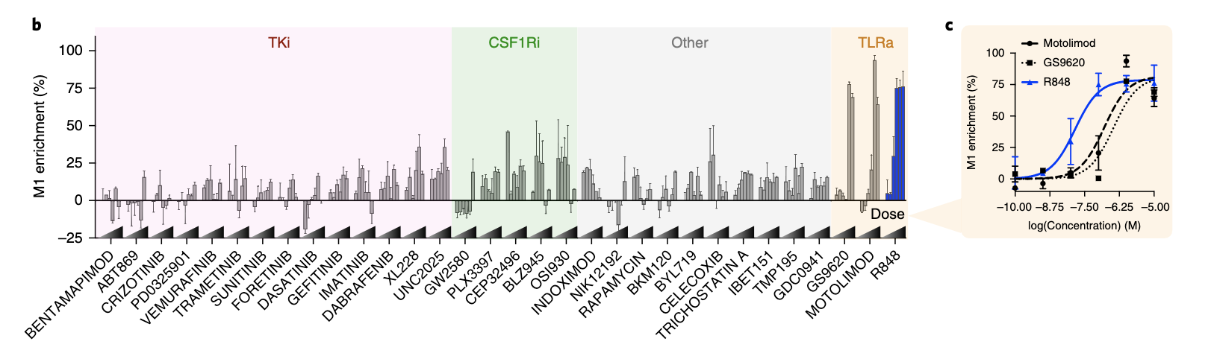
Strategies to reeducate TAMs
Rodell et al., “TLR7/8-agonist-loaded nanoparticles promote the polarization of tumour-associated macrophages to enhance cancer immunotherapy,” .
Notes:
A study by . Rodell et al., reviewed major M1 enrichment existing strategies and showed that the largest macrophage polarization effects were observed for agonists of the toll-like receptors 7 and 8 (TLR7/8) and more specifically R848

Slide 11
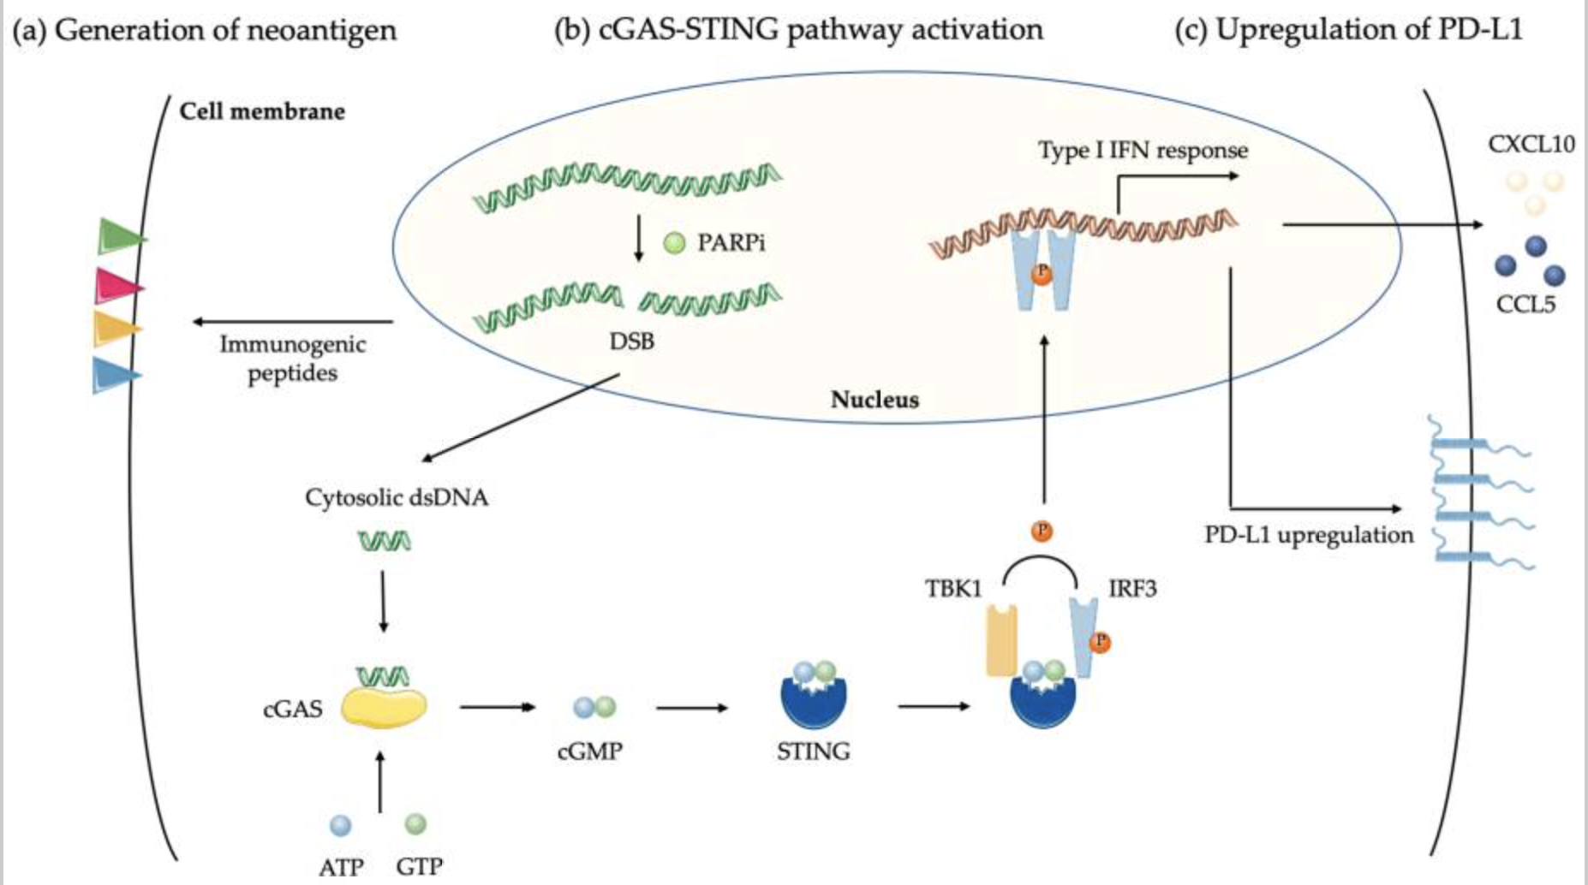
Biological effects of PARP Inhibitor on Cancer Cells
F. Peyraud and A. Italiano, “Combined PARP Inhibition and Immune Checkpoint Therapy in Solid Tumors” .
Notes:
PARP inhibitors (PARPi) operate by delaying the repair of DNA, which results in severe DNA damage in cancer cells. This increases the presence of neoantigens and the tumor mutation burden.
PARPi induction results in the creation of DNA fragments.
These fragments, when they bind to cyclic GMP-AMP synthase (cGAS), activate the STING pathway.
This activation causes an increase in CCL5 and CXCL10 chemokines that help in the recruitment of T cells.
The STING pathway also triggers an increase in PD-L1, which could have a synergistic effect with an anti-PD1/PD-L1 ICI therapy.
Research suggests also that the pairing of CSF1 with PARP inhibitors can restrain tumor growth and improve treatment outcomes.
In our solution, we will use due to its superior potency R848 instead of CSF1 inhibitor expecting the same benefits.

Slide 12
Agenda
Significance
Innovation
Research Strategy

Slide 13
Research Strategy

Slide 14
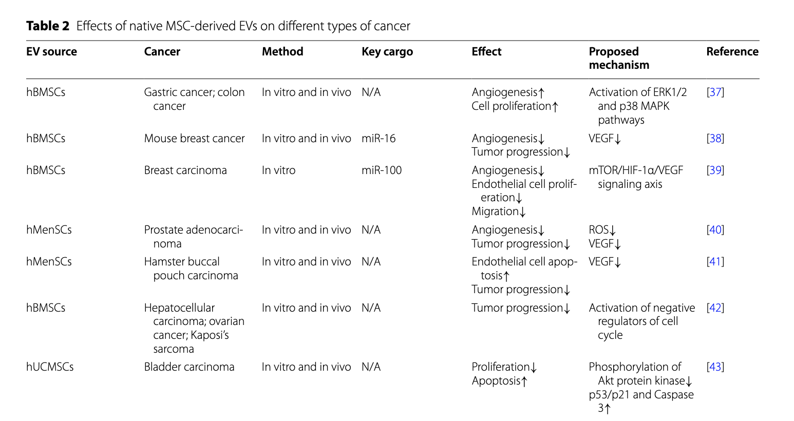
Effects of MSC-derived EVs on Different Types of Cancers
iPSC-MSC-EV Advantages
Anti-Inflammatory Bioactivity
Donor Availability
Scalability
Could induce M2-like transition
Z. Weng et al., “Therapeutic roles of mesenchymal stem cell-derived extracellular vesicles in cancer,” J. Hematol. Oncol., vol. 14, no. 1, p. 136, 2021, doi: 10.1186/s13045-021-01141-y
Notes:
There have been a lot of research to understand which MSCs are suitable for secreting exosomes adequate for cancer.
Induced pluripotent stem cells (iPSCs)-MSC have multiple advantages and they will be used in our design.

Slide 15
Aim 1: Development of PARPi and TLR 7/8 Inhibitors Exosome-based EVs
1. To Enrich the M1 population of tumor-associated macrophages (TAMs) and modulate TAM recruitment and distribution.
Approach: Utilize chemical conjugation techniques to attach R848 to the exosome surface.
2. To Create dual-targeting exosomes that selectively target TAMs while evading the immune system via CD47 expression, which signals "don't eat me" to phagocytes.
Approach: Combine CD47 Expression with TAM-Specific Ligands.
Introduce vectors encoding CD47 into cell cultures that will be used to harvest exosomes. Use covalent attachment to attach antibodies against M2-like TAM marker CD80 to the exosome surface.
3. To ensure that exosomes are sufficiently expressing CD47 to avoid uptake macrophages and dendritic cells of the MPS without impairing the ability to target specific cells at the tumor site.
Approach: optimize the level of CD47 expression on exosomes using a promoter with adjustable strength to find the right balance where exosomes can evade phagocytosis without completely inhibiting macrophage interaction where needed.
4. Modify the R848 molecule for pH-sensitive release near the cancer cells.
Approach: Synthesize a peptide linker that is sensitive to the acidic pH typical of tumor environments. This peptide should include a sequence specific to the matrix metalloproteinase-2 (MMP-2), which is often overexpressed in tumor tissues.
Notes:
The next steps in our research consist in:
Conjugating the exosome surface with R848 to enrich the M1 population of TAMs and modulate TAM recruitment and distribution
Combining CD47 expression: and incorporating TAM-specific ligands, such as antibodies against M2-like TAM markers, e.g., CD163, on the exosome surface along with CD47 expression.
This dual targeting approach enables selective TAM targeting despite CD-47-mediated immune evasion.
Fine-tuning CD47 Expression Levels: on exosomes to balance immune evasion with M2-like TAM targeting. This optimization can enhance exosome biodistribution and maximize TAM targeting.
Integrating a pH-Sensitive component:
We will modify the R848 cargo to include a functional group compatible with click chemistry; and attach it via a peptide linker to MMP-2, a protein found in cancer cells.
This setup allows selective release of R848 near the cancer cells.

Slide 16
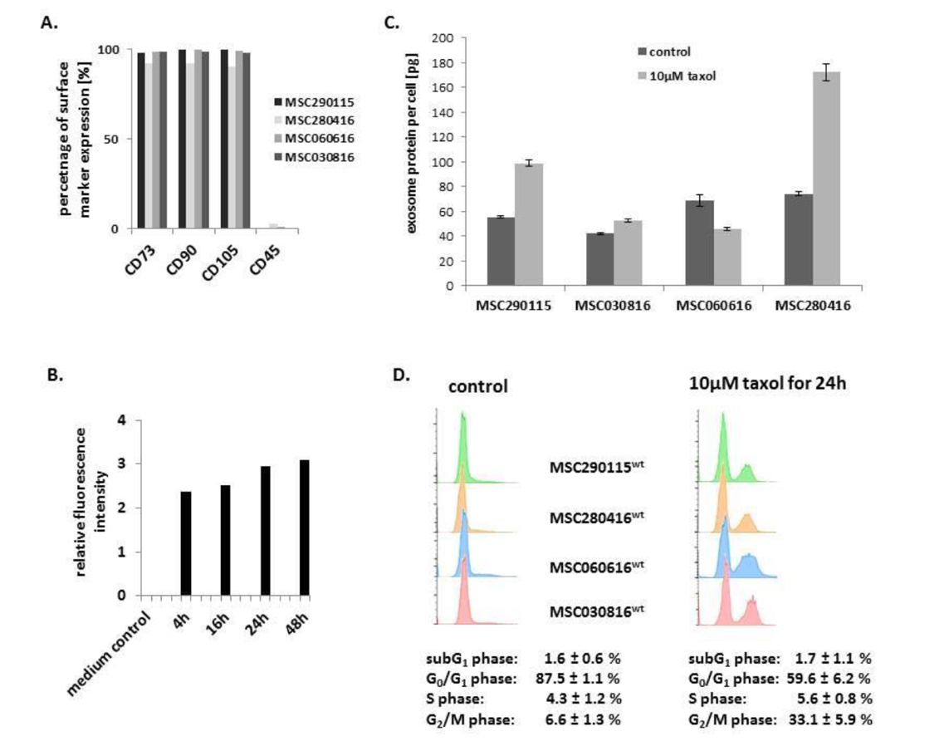
Assessment of Cytotoxic Effects of Engineered Exosomes Produced by MSCs
A) Characterization of four different MSC investigated populations.
B) Kinetic of exosomes production by MSC^{GFP}: progressive exosome release increase to reach a plateau after 24h.
C) Quantification of exosome produced per cell within a specific timeframe.
D) Apoptotic/necroptotic subG1 phase cells should remain at equally low levels in control and drug treated MSC populations: confirming no detectable cytotoxic effects.
Catharina Melzer et al., “Taxol-Loaded MSC-Derived Exosomes Provide a Therapeutic Vehicle to Target Metastatic Breast Cancer and Other Carcinoma Cells”
Notes:
Following the methodology outlined in previous research by Merlzer et al. [33] (Fig. 6), we will start by assessing the viability and efficiency of iPSC-MSCs in producing the EVs.
This step involves determining which cell lines have the least cytotoxic effects while maintaining high productivity of exosome secretion.

Slide 17
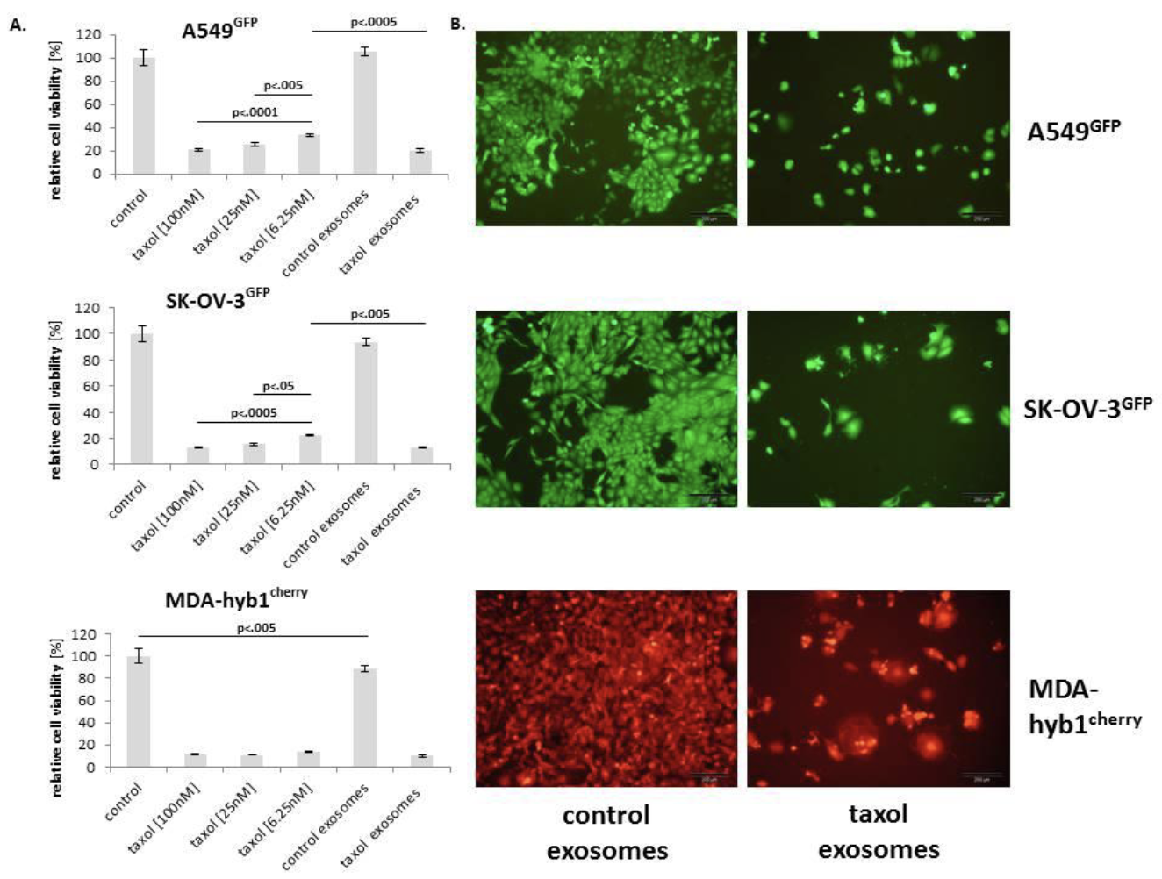
Aim 2: In Vitro Evaluation of Therapeutic Efficacy and Specificity
Relative chemotherapeutic response of different human cancer cell populations, including:
A549GFP lung cancer (upper panel),
SK-OV-3GFP ovarian cancer (middle panel),
MDA-hyb1cherry breast cancer (lower panel) cells
Catharina Melzer et al., “Taxol-Loaded MSC-Derived Exosomes Provide a Therapeutic Vehicle to Target Metastatic Breast Cancer and Other Carcinoma Cells”
Notes:
To evaluate the potency of the drug-loaded engineered EVS, we will utilize 4 human cancer cell lines
These cell lines will be exposed to sub-lethal doses of R848-loaded exosomes for 24 hours to prime them.
Following the treatment, we will employ Liquid Chromatography-Mass Spectrometry (LC-MS) to measure the quantity of R848 that has been delivered to the cancer cells by the MSC-derived exosomes.
This measurement consists in comparing the exosome uptake by the cancer cells to control groups, such as untreated cancer cells, or cancer cells treated with free R848.
The data from LC-MS analysis will not only quantify the drug delivery but also help in evaluating how specifically and effectively the engineered exosomes target cancer cells with R848.
This step is crucial in understanding the potential of MSC-derived exosomes as a delivery system for therapeutic agents.
The cytotoxic effects will be assessed using a fluoroscan assay, in which the reduction in florescence indicates cell death among the drug-loaded cancer cells.
We will then analyze cell growth and viability and compare the results with those of our control cells

Slide 18
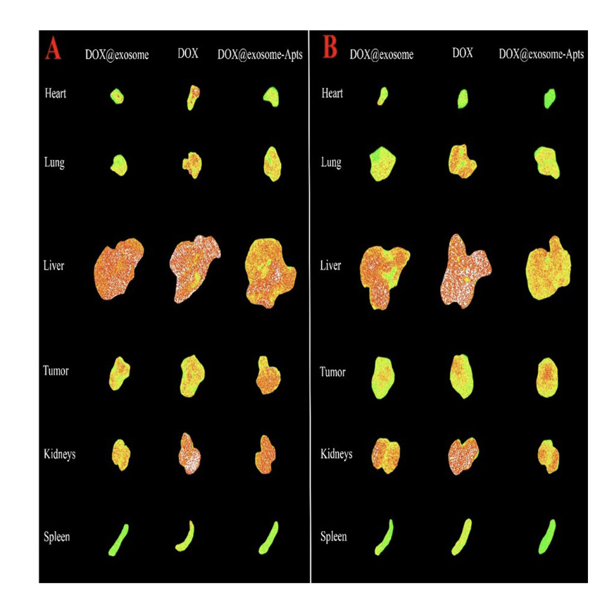
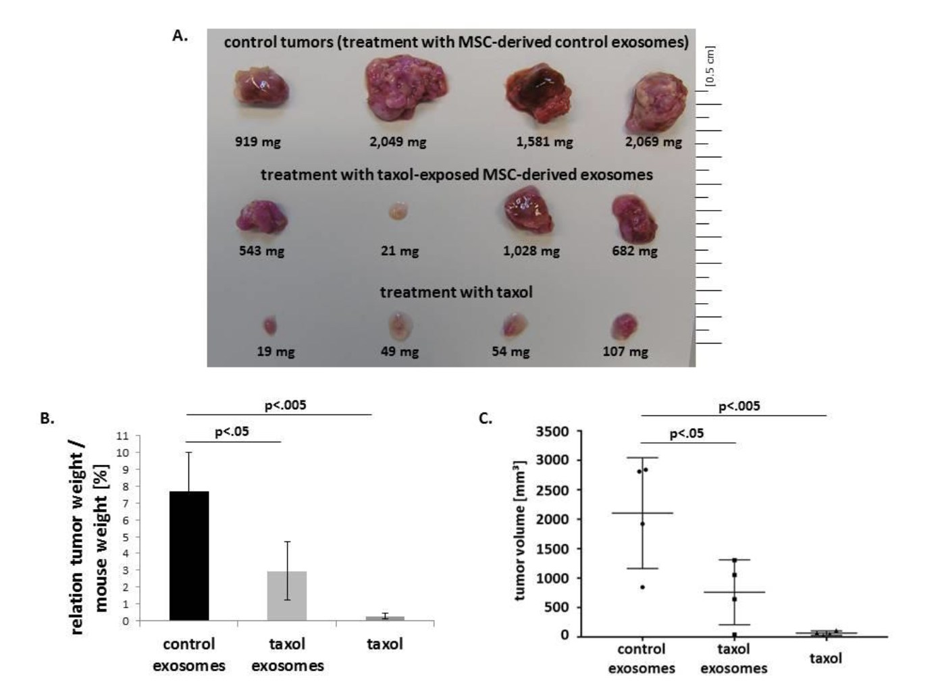
Aim 3:In Vivo Efficacy and Safety Evaluation
We anticipate a reduction in tumor volume and in metastasis when administering R848-loaded exosomes, at dosages lower than those used for free R848 injections
Fluorescence images of tumor, liver, spleen, kidneys, heart, and lungs of
tumor-bearing mouse models after 6h and 24h post injection
Elnaz Bagheri et al.,
Notes:
Based on study from Elnaz Baheri et al., we will use hematolymphoid humanized mice as they are the most promising animal models to test the antitumor effects of checkpoints blockers and immunotherapy strategies.
Each mouse will be treated with either only R848 or MSC-derived exosomes.
After a month of treatment, animals will sacrificed, and their tumors dissected to measure immune cell infiltration within the tumor, and their volume before and after treatment
We anticipate a reduction in tumor volume and in metastasis when administering R848-loaded exosomes, at dosages lower than those used with free R848 injection.
We will also use flow cytometry to identify and quantify the types of immune cells present in the TME, we must see a T cell infiltration increase.
The research will also include specific assays designed to detect TAM infiltration and the prevalence of the M1 phenotype, using TAM-specific antibodies for CD80.

Slide 19
Conclusion
Successfully designing this novel therapy depends on 3 critical aspects: evading detection by the MPS, effectively targeting M2-like macrophages, and ultimately reaching cancer cells. We are confident that these 3 key aspects of our research could be effectively addressed by fine tuning the design of the drug.
This novel therapy in combination with anti-pd1/pdl1, by addressing the resistance to these therapies could potentially revolutionize cancer treatment
Notes:
In conclusion, a successful design of this novel therapy depends on 1) evading detection by the MPS, 2) targeting M2-like macrophages and 3) reach the cancer cells to inject the lethal drug. We are confident that a fine tuning of each aspect of the design of this drug will address each of these key points.
This therapy by addressing the resistance of immunotherapies such as anti-pd1/pdl1 and in combination with these drugs, could potentially revolutionize cancer treatment.

Slide 20
References
Turning cold tumors into hot tumors by improving T cell infiltration Yuan-Tong Liu, Zhi-Jun Sun doi: 10.7150/thno.58390
C. Peña-Romero and E. Orenes-Piñero, “Dual Effect of Immune Cells within Tumour Microenvironment: Pro- and Anti-Tumour Effects and Their Triggers,” Cancers, vol. 14, no. 7, p. 1681, 2022, doi: 10.3390/cancers14071681
Tong et al., “Tumor Associated Macrophages, as the Dominant Immune Cells, Are an Indispensable Target for Immunologically Cold Tumor—Glioma Therapy?,” Front. Cell Dev. Biol., vol. 9, p. 706286, 2021, doi: 10.3389/fcell.2021.706286
X. Shen et al., “TAM-targeted reeducation for enhanced cancer immunotherapy: Mechanism and recent progress,” Front. Oncol., vol. 12, p. 1034842, 2022, doi: 10.3389/fonc.2022.1034842
Jiachen Wen et al, “CSF1R inhibitors are emerging immunotherapeutic drugs for cancer treatment” - doi: 10.1016/j.ejmech.2022.114884 Elsevier - European Journal of Medicinal Chemistry
F. Peyraud and A. Italiano, “Combined PARP Inhibition and Immune Checkpoint Therapy in Solid Tumors,” Cancers, vol. 12, no. 6, p. 1502, 2020, doi: 10.3390/cancers12061502
Zhijie Weng et al. Therapeutic roles of mesenchymal stem cell-derive extracellular vesicles in cancer. Journal of Hematology & Oncology 2021 - doi: 10.1186/s13045- 021-01141-y
Cristiana Ulpiano et al., “Bioengineered Mesenchymal-Stromal-Cell-Derived Extracellular Vesicles as an Improved Drug Delivery System:Methods and Applications” - Biomedicines 2023 – doi: 10.3390/biomedicines11041231
Catharina Melzer et al., “Taxol-Loaded MSC-Derived Exosomes Provide a Therapeutic Vehicle to Target Metastatic Breast Cancer and Other Carcinoma Cells” - CANCERS 2019, doi: 10.3390/cancers11060798
Elnaz Bagheri et al., “Targeted doxorubicin-loaded mesenchymal stem cells-derived exosomes as a versatile platform for fighting against colorectal cancer” – Life Sciences 261 2020 – doi: 10.1016/j.lfs.2020.118369
C. B. Rodell et al., “TLR7/8-agonist-loaded nanoparticles promote the polarization of tumour-associated macrophages to enhance cancer immunotherapy,” Nat. Biomed. Eng., vol. 2, no. 8, pp. 578–588, 2018, doi: 10.1038/s41551-018-0236-8

Slide 21


